Slide 1

Types/ways of communication
Student’s Group : AB.RAFEH_104
Section : CS II - C
Course : ENG201 – Communication Skills
Course Instructor :

Slide 2

Content
What is communication?
Process of communication
Types of communication
Verbal Communication
Non-Verbal Communication
Written Communication
Formal & Informal Communication
Visual Communication
Listening Techniques
Speaking Techniques

Slide 3
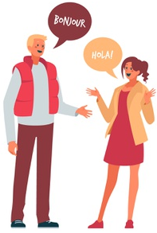
What is communication?
The word communication has originated from a Latin word “Communes” which means something common.
Communication is a process of exchanging information, ideas, thoughts, feeling and emotions through speech signals, writing or behavior. In communication process, a sender encodes a message and then using a medium and send it to appropriate feedback using a medium.

Slide 4
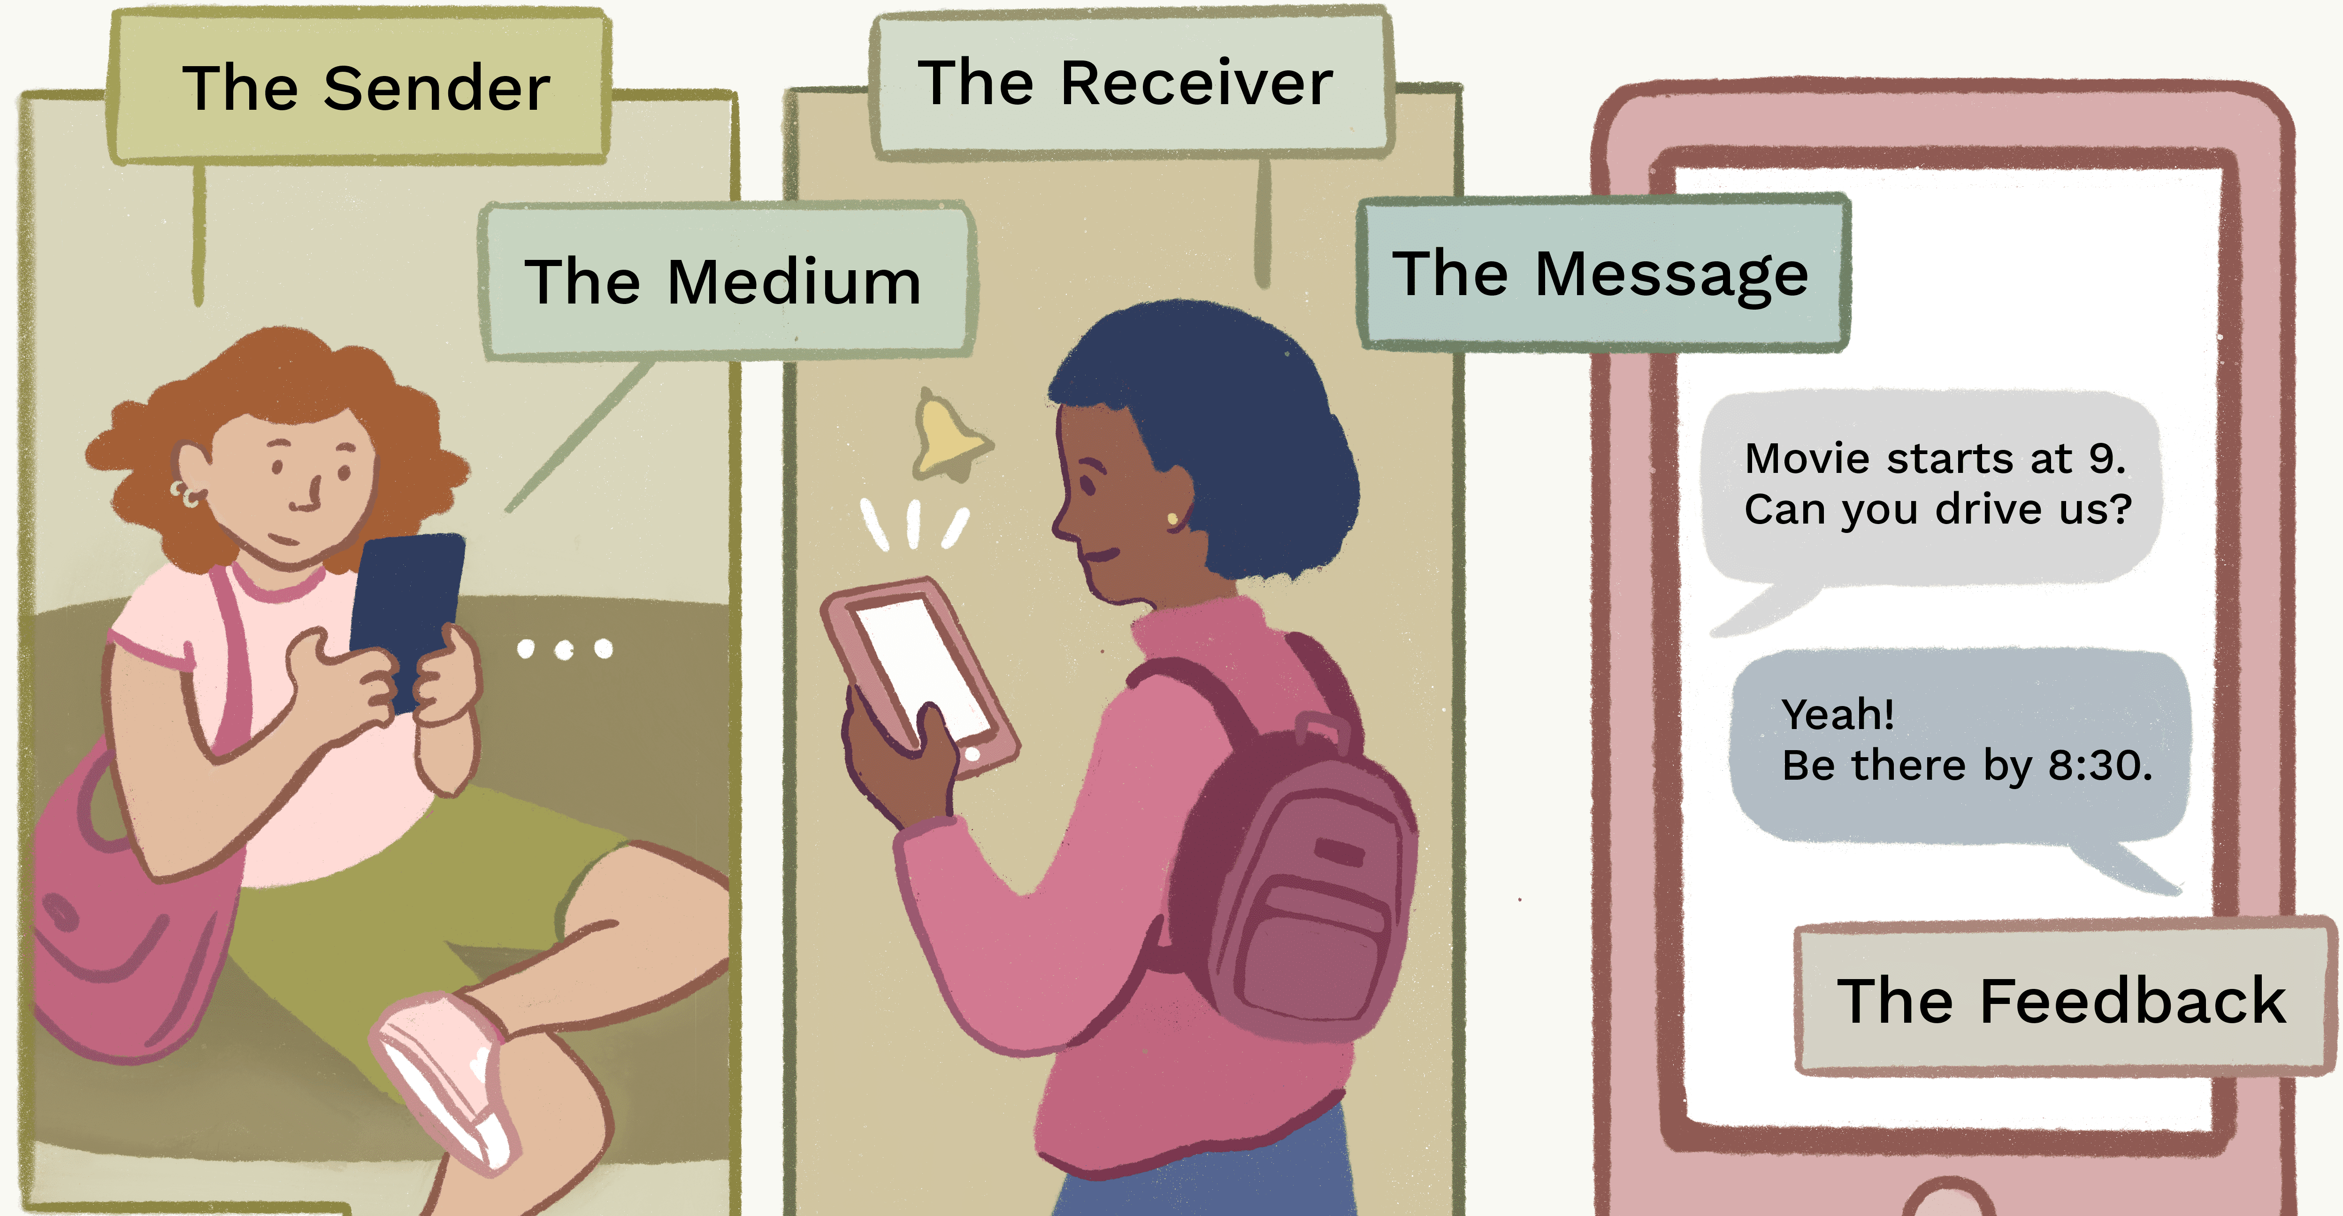
Process of communication
Encoding
Message
Channel
Receiver
Decoding
Feedback
Channel
Sender

Slide 5
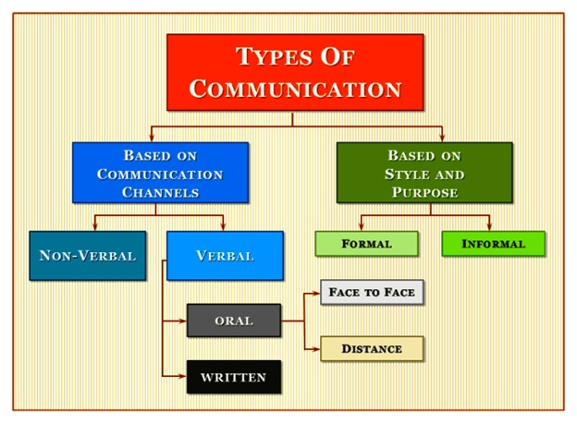
types of communication

Slide 6

types of communication
Verbal Communication:
Verbal communication refers to the form of communication in which message is transmitted verbally, communication is done by word, mouth and a piece of writing. Objective of every communication is to have people understood what we are trying to convey.

Slide 7
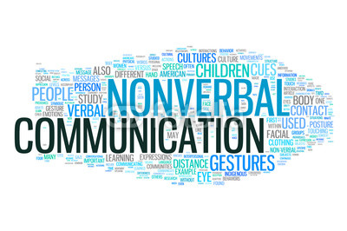
types of communication
Non-Verbal Communication:
Non-Verbal communication is the sending or receiving of wordless messages. Such as gesture, body language, posture, tone of voice or facial expressions, is called nonverbal communication.

Slide 8
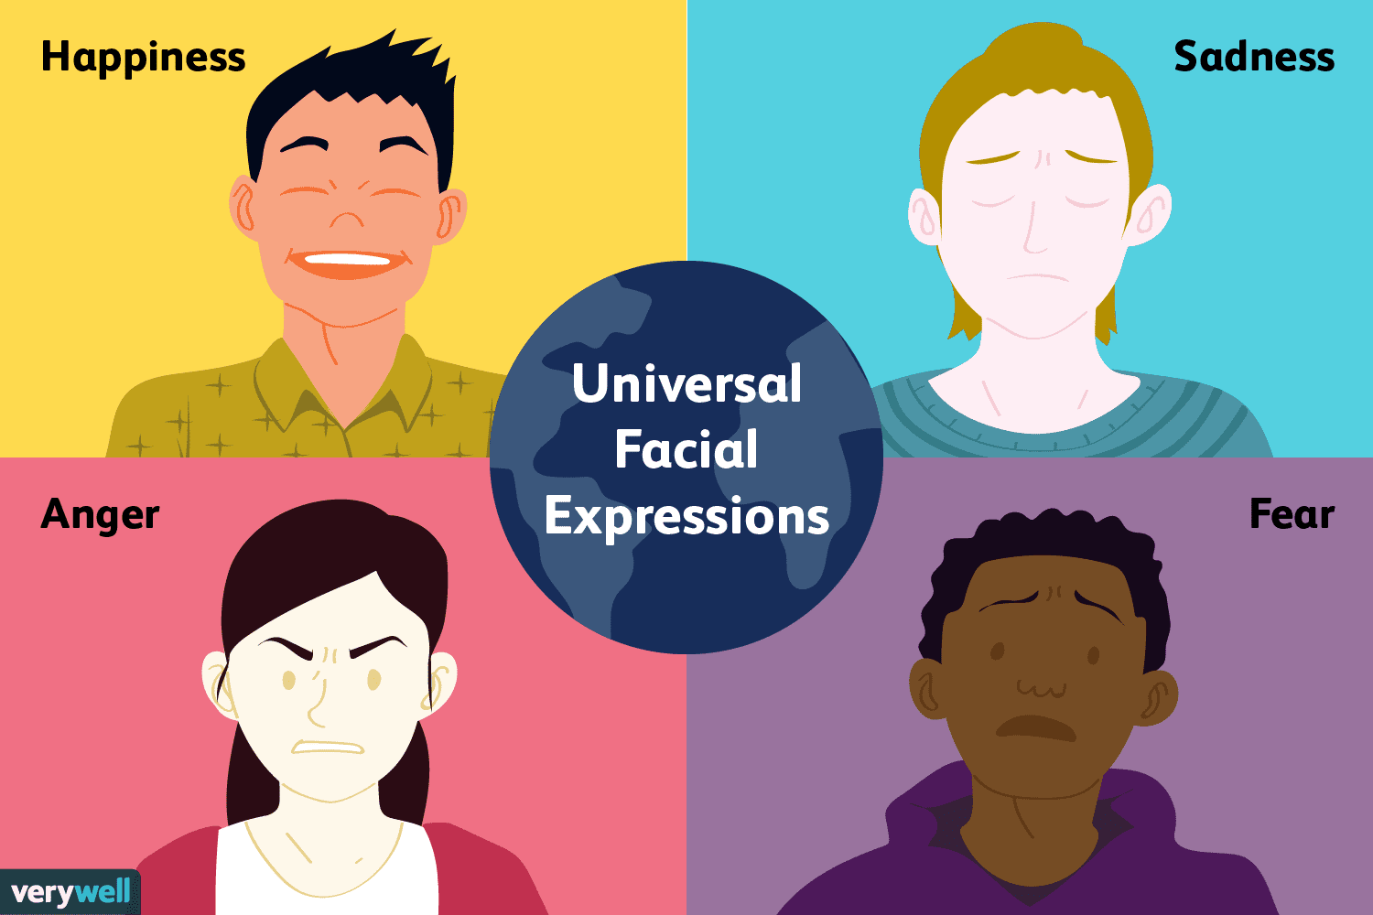
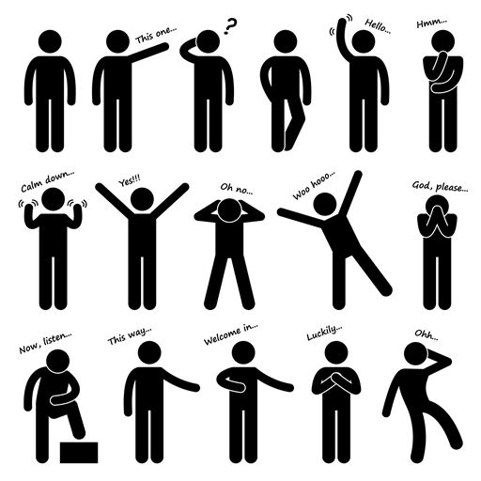
Non-Verbal Communication:
Non-Verbal communication has the following elements:
Facial Expression
Posture
Body space & proximity
Touch
Personal Appearance
Eye Contact
Sounds
Silence

Slide 9

types of communication
Written Communication:
In written communication, written signs or symbols are used to communicate. A written message may be printed or hand written. In written communication message can be transmitted via email, letter, report, memo etc. message, in written communication, is influenced by the vocabulary & grammar used, writing style, precision and clarity of the language used.

Slide 10
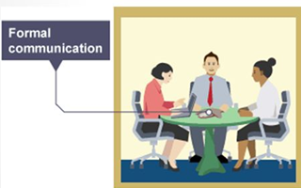
types of communication
Formal Communication:
Formal communication is communication structured on the basis of hierarchy, authority & accountability.
When you want to finalize policy and want to decide a course to adopt, then formal communication is more effective.
Any promises or any official plans need to be formally documented so that they can be referred to later.

Slide 11
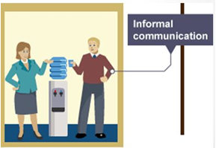
types of communication
Informal Communication:
Informal communication is relatively less structured & spontaneous communication arising out of day to day routine & meetings among people.
Informal communication helps the “Open door policy” and makes people more confident and forthcoming with their ideas and creativity.
Informal communication does not incite fear into people’s mind.
Informal talks encourage people to share their problems.

Slide 12

types of communication
Visual Communication:
Visual communication is basically described as communication through the use of visual aids. It is communication through means that can be seen read or looked upon. It is the most effective method of communication available. In the modern age there are tools that aid the process of visual communication for people that are far apart from each other.
Importance of visual communication that we communicate with audience through Picture, Video/Film etc. Presenting a ideas without depending on notes.

Slide 13
Listening Techniques :
Listening is an intellectual, linguistic activity
Listen for meaning and for purpose
Listen attentively to others what they are peaking about
Listening improves thought provoking skills
Speaking Techniques:
Speak confidently
Speak freely and fluently
Speak word endings very clearly
Speak not too slow or too fast
Speak to express not to impress

Slide 14
Making a good first impression:
A firm handshake is really important - if you're not confident about this, you could practice shaking hands with your friends.
Maintain appropriate eye contact - this conveys that you are listening, and that you are interested in what you are being told. It also adds an impression of honesty to your answers.
Don't slouch, and keep both feet on the floor. Keep your hands relaxed and don't fiddle with a pen or your hair.
Don't gesticulate too much, as this might make you come across as a bit aggressive and can detract attention from what you are saying.

Slide 15


